Slide 1
DSE 6220
Big Data
Hadoop & Spark
Week 2

Slide 2
Hadoop Fundamentals
Instead of performing a task on a single large machine, spread the work across many machines
Commodity hardware is generally cheap
Scale out vs scale up
Scaling up generally is more expensive than scaling out
Redundancy
Data is replicated across the server to provide backups in case a node fails or dies
Name Node – Considered the master & contains the cluster metadata
Second name node is not a backup, it provides housekeeping procedures when primary is restart
Data Node – Individual servers which are responsible for storing data and processing data that resides on that node
Hadoop Common – basic system requirements
HDFS – the file system, what manages where the data is stored and accessed
Hadoop MapReduce
Each worker completes tasks on the data that resides on that machine
Data is aggregated (reduced) back to the master
YARN – scheduling & resource management

Slide 3
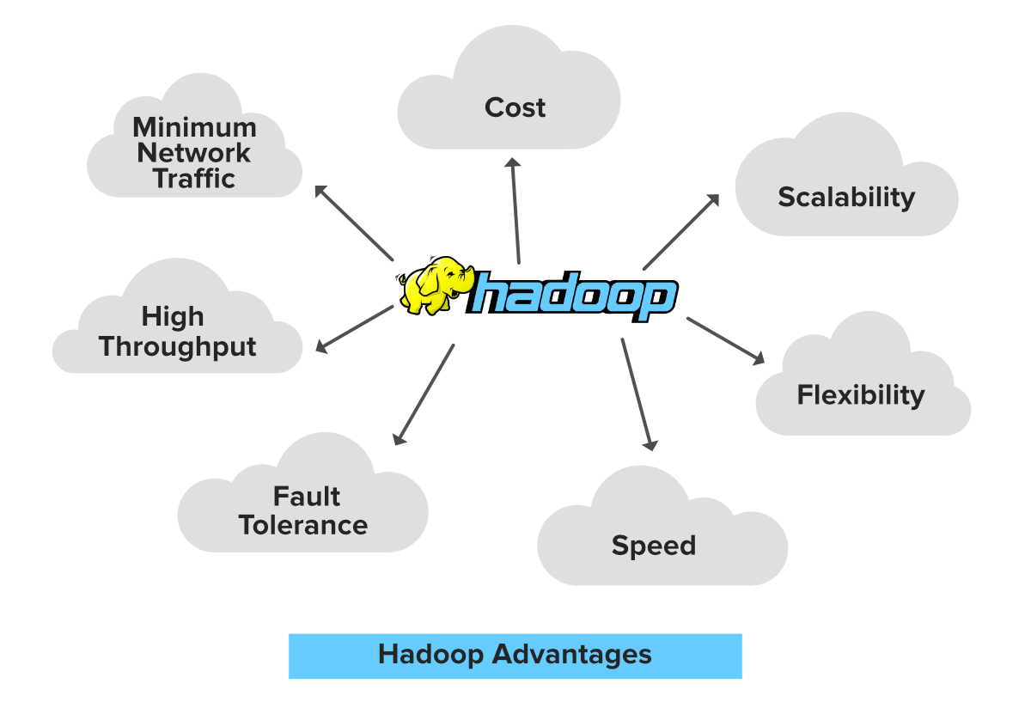
Hadoop Pros
1. Cost Hadoop is open-source and uses cost-effective commodity hardware which provides a cost-efficient model, unlike traditional Relational databases that require expensive hardware and high-end processors to deal with Big Data. The problem with traditional Relational databases is that storing the Massive volume of data is not cost-effective, so the company’s started to remove the Raw data. which may not result in the correct scenario of their business. Means Hadoop provides us 2 main benefits with the cost one is it’s open-source means free to use and the other is that it uses commodity hardware which is also inexpensive.
2. Scalability Hadoop is a highly scalable model. A large amount of data is divided into multiple inexpensive machines in a cluster which is processed parallelly. the number of these machines or nodes can be increased or decreased as per the enterprise’s requirements. In traditional RDBMS(Relational DataBase Management System) the systems can not be scaled to approach large amounts of data.
3. Flexibility Hadoop is designed in such a way that it can deal with any kind of dataset like structured(MySql Data), Semi-Structured(XML, JSON), Un-structured (Images and Videos) very efficiently. This means it can easily process any kind of data independent of its structure which makes it highly flexible. which is very much useful for enterprises as they can process large datasets easily, so the businesses can use Hadoop to analyze valuable insights of data from sources like social media, email, etc. with this flexibility Hadoop can be used with log processing, Data Warehousing, Fraud detection, etc.
4. Speed Hadoop uses a distributed file system to manage its storage i.e. HDFS(Hadoop Distributed File System). In DFS(Distributed File System) a large size file is broken into small size file blocks then distributed among the Nodes available in a Hadoop cluster, as this massive number of file blocks are processed parallelly which makes Hadoop faster, because of which it provides a High-level performance as compared to the traditional DataBase Management Systems. When you are dealing with a large amount of unstructured data speed is an important factor, with Hadoop you can easily access TB’s of data in just a few minutes.
5. Fault Tolerance Hadoop uses commodity hardware(inexpensive systems) which can be crashed at any moment. In Hadoop data is replicated on various DataNodes in a Hadoop cluster which ensures the availability of data if somehow any of your systems got crashed. You can read all of the data from a single machine if this machine faces a technical issue data can also be read from other nodes in a Hadoop cluster because the data is copied or replicated by default. Hadoop makes 3 copies of each file block and stored it into different nodes.
6. High Throughput Hadoop works on Distributed file System where various jobs are assigned to various Data node in a cluster, the bar of this data is processed parallelly in the Hadoop cluster which produces high throughput. Throughput is nothing but the task or job done per unit time.
7. Minimum Network Traffic In Hadoop, each task is divided into various small sub-task which is then assigned to each data node available in the Hadoop cluster. Each data node process a small amount of data which leads to low traffic in a Hadoop cluster.

Slide 4
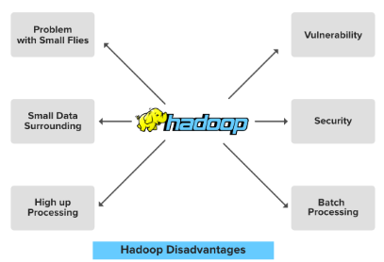
Hadoop Cons
1. Problem with Small files Hadoop can efficiently perform over a small number of files of large size. Hadoop stores the file in the form of file blocks which are from 128MB in size(by default) to 256MB. Hadoop fails when it needs to access the small size file in a large amount. This so many small files surcharge the Namenode and make it difficult to work.
2. Vulnerability Hadoop is a framework that is written in java, and java is one of the most commonly used programming languages which makes it more insecure as it can be easily exploited by any of the cyber-criminal.
3. Low Performance In Small Data Surrounding Hadoop is mainly designed for dealing with large datasets, so it can be efficiently utilized for the organizations that are generating a massive volume of data. It’s efficiency decreases while performing in small data surroundings.
4. Lack of Security Data is everything for an organization, by default the security feature in Hadoop is made un-available. So the Data driver needs to be careful with this security face and should take appropriate action on it. Hadoop uses Kerberos for security feature which is not easy to manage. Storage and network encryption are missing in Kerberos which makes us more concerned about it.
5. High Up Processing Read/Write operation in Hadoop is immoderate since we are dealing with large size data that is in TB or PB. In Hadoop, the data read or write done from the disk which makes it difficult to perform in-memory calculation and lead to processing overhead or High up processing.
6. Supports Only Batch Processing The batch process is nothing but the processes that are running in the background and does not have any kind of interaction with the user. The engines used for these processes inside the Hadoop core is not that much efficient. Producing the output with low latency is not possible with it.

Slide 5
HDFS Hadoop File System
What is it
How does it work
Literally a file system like on Windows
Namespaces – Provides namespaces that hold cluster metadata, that is, the location of data in the Hadoop cluster
Data storage – Acts as storage for data used in the cluster
Data is again redundant, if one location is unavailable Hadoop will query the namespace to find another location
Name Node (Hadoop master) receives a request to write a new file
Data is cached into chunks to be written
Name Node directs where the data will be stored (node & disk block)
HDFS writes the data to the target Data Node and tells the Name Node when it is finished
Target Data Node copies its data to a second Data Node to ensure redundancy
This process can be completed depending on your required level of redundancy
Process completes until each block (file) has been written

Slide 6
HDFS (Cont.)
Hardware Failure
Hardware failure is the norm rather than the exception. An HDFS instance may consist of hundreds or thousands of server machines, each storing part of the file system’s data. The fact that there are a huge number of components and that each component has a non-trivial probability of failure means that some component of HDFS is always non-functional. Therefore, detection of faults and quick, automatic recovery from them is a core architectural goal of HDFS.
Streaming Data Access
Applications that run on HDFS need streaming access to their data sets. They are not general purpose applications that typically run on general purpose file systems. HDFS is designed more for batch processing rather than interactive use by users. The emphasis is on high throughput of data access rather than low latency of data access. POSIX imposes many hard requirements that are not needed for applications that are targeted for HDFS. POSIX semantics in a few key areas has been traded to increase data throughput rates.
Large Data Sets
Applications that run on HDFS have large data sets. A typical file in HDFS is gigabytes to terabytes in size. Thus, HDFS is tuned to support large files. It should provide high aggregate data bandwidth and scale to hundreds of nodes in a single cluster. It should support tens of millions of files in a single instance.
Simple Coherency Model
HDFS applications need a write-once-read-many access model for files. A file once created, written, and closed need not be changed. This assumption simplifies data coherency issues and enables high throughput data access. A MapReduce application or a web crawler application fits perfectly with this model. There is a plan to support appending-writes to files in the future.
“Moving Computation is Cheaper than Moving Data”
A computation requested by an application is much more efficient if it is executed near the data it operates on. This is especially true when the size of the data set is huge. This minimizes network congestion and increases the overall throughput of the system. The assumption is that it is often better to migrate the computation closer to where the data is located rather than moving the data to where the application is running. HDFS provides interfaces for applications to move themselves closer to where the data is located.
Portability Across Heterogeneous Hardware and Software Platforms
HDFS has been designed to be easily portable from one platform to another. This facilitates widespread adoption of HDFS as a platform of choice for a large set of applications.

Slide 7


Slide 8
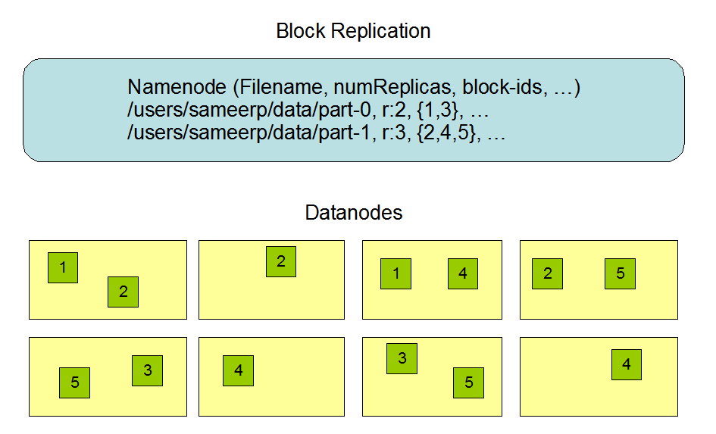

Slide 9
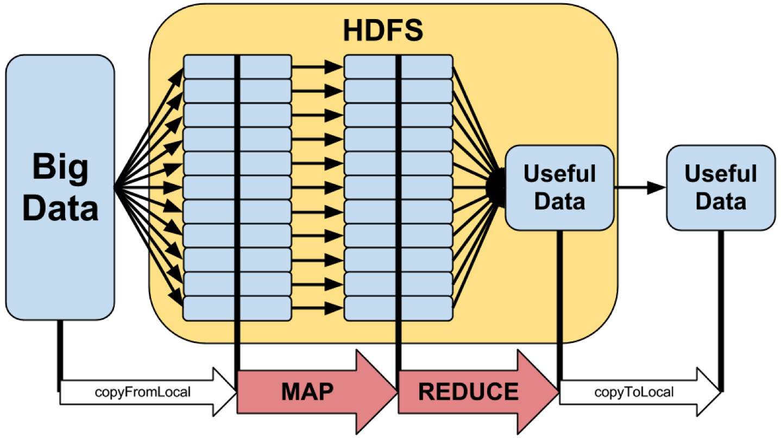
MapReduce Hadoop MapReduce is a software framework for easily writing applications which process vast amounts of data (multi-terabyte data-sets) in-parallel on large clusters (thousands of nodes) of commodity hardware in a reliable, fault-tolerant manner.
Mapper
Name Node maps task to workers depending on the HDFS meta data
Tasks that modify data are completed here
Shuffle.
Worker nodes redistribute data based on the output keys (produced by the map function), such that all data belonging to one key is located on the same worker node.
Reducer
Takes the K/V from the mapper and performs a summarization operation
Reduces data from all nodes into the ‘edge’ node or node where the work is being directed from

Slide 10
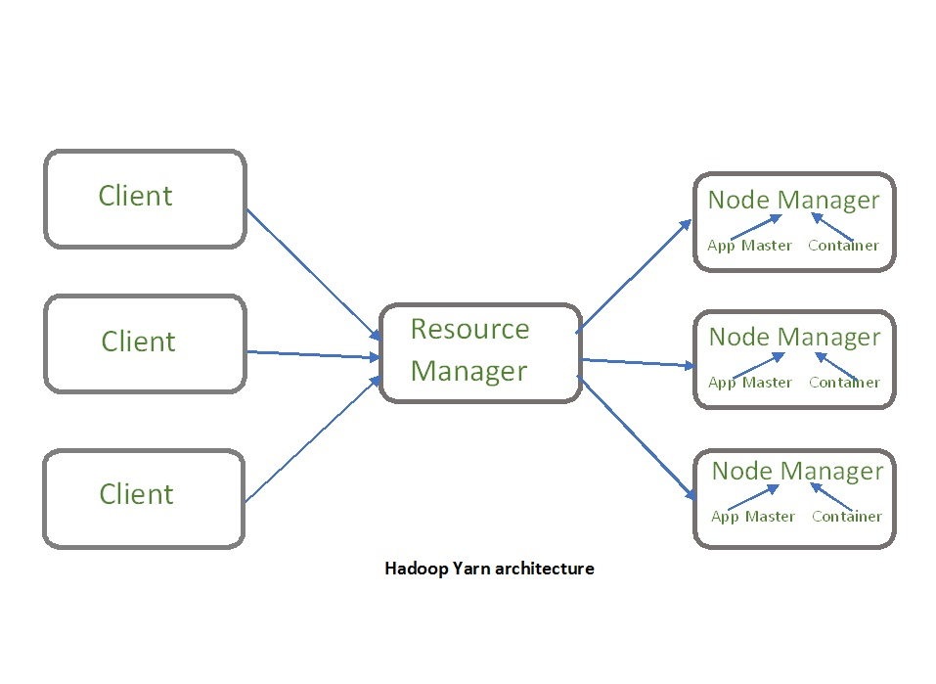
YARN Yet Another Resource Manager The fundamental idea of YARN is to split up the functionalities of resource management and job scheduling/monitoring into separate daemons. The idea is to have a global ResourceManager (RM) and per-application ApplicationMaster (AM). An application is either a single job or a DAG of jobs.
Manages & monitors jobs
Application Master
Assigns and manages resources for each task on the cluster
Containers
Each job assigns ‘containers’ to each of the workers in the job
Have their own memory and CPU
Node Managers
Reports the status of jobs to the Resource Manager

Slide 11
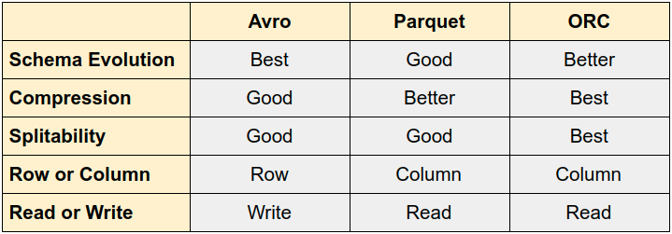
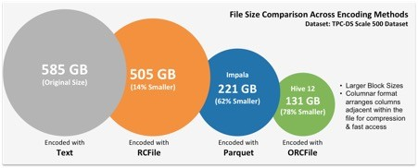
Data Storage Formats
Parquet
The most commonly used data format in HDFS
Compressed columnar format
ORC
Optimized Row-Columnar
Optimized for queries where rows need to be filtered
AVRO
Stores data and schema registry in compressed binary
Schema resolution
Very important and the book missed this
Allows schema evolution, basically if your columns change AVRO will automatically handle the differences for you
Text/CSV
Not compressed and typically not used in Hadoop for storing data

Slide 12
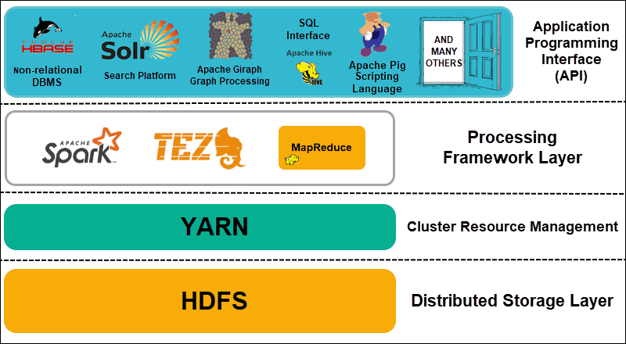
Hadoop Tools
Pig
Paradigm that allows for easy writing of mappers and reducers
Hbase
Similar to Google’s Big Table
Indexed by column, row, and timestamp
Hive
SQL engine for HDFS
Sqoop
Used to extract data from traditional databases
Flume
Used for management, aggregation, and analysis of log data
Kafka
Used for real time streaming

